Slide 1
Quantum Computing Architectures (EE274) Lecture 21
Hiu-Yung Wong
apr. 17, 2023
hiuyung.wong@sjsu.edu, Office: ENG363
http://www.sjsu.edu/people/hiuyung.wong/index.html

Slide 2
Outline
Circuit Quantization
Superconducting Qubit Readout
Energy Participation Ratio (Project)

Slide 3
Announcement

Slide 4
Circuit Quantization (Circuit Quantum Electro-Dynamics CQED)
Chapter 15 of “Quantum Computing Architecture and Hardware for Engineers: Step by Step”

Slide 5
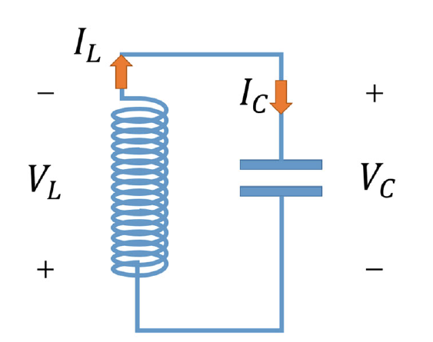
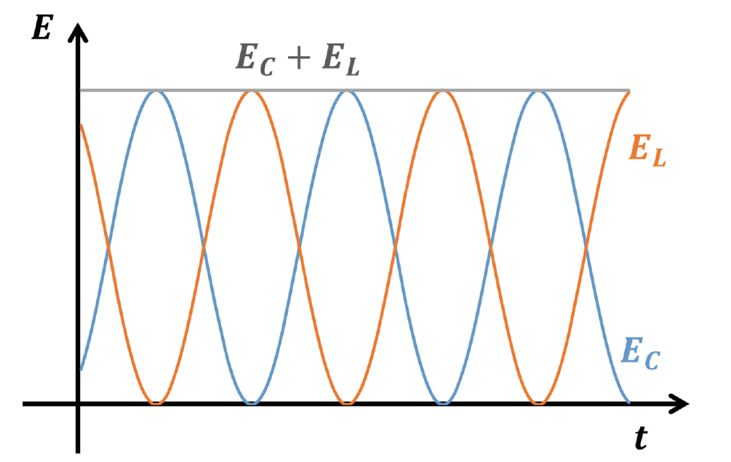
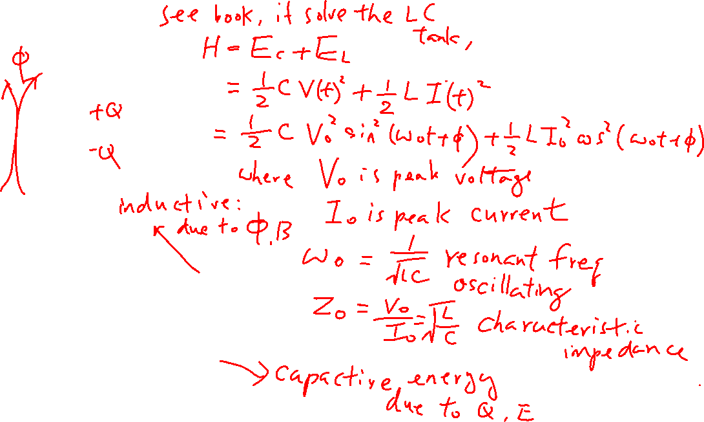
LC Circuit
Learning outcomes: Understand the relationship between classical and quantum treatment of a LC tank

Slide 6
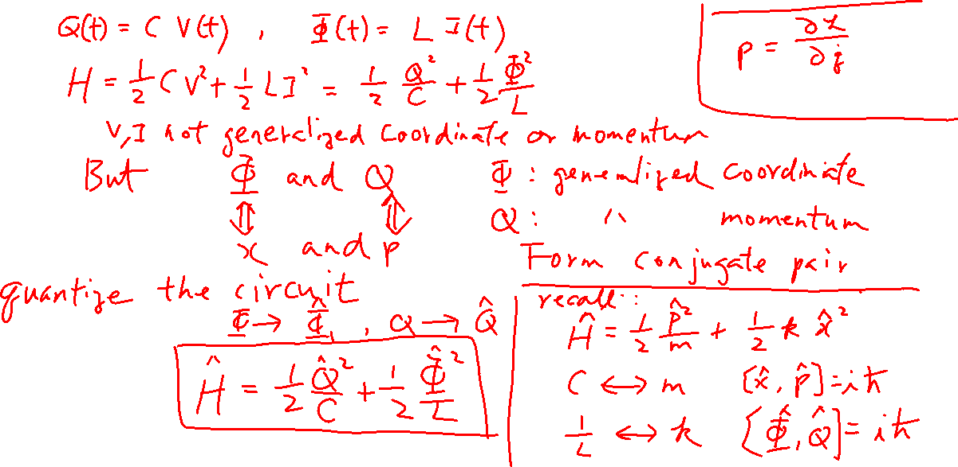
Quantization of LC Circuit
Learning outcomes: Understand the relationship between classical and quantum treatment of a LC tank

Slide 7
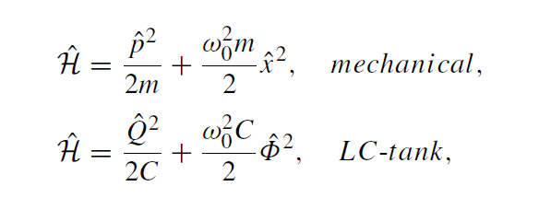
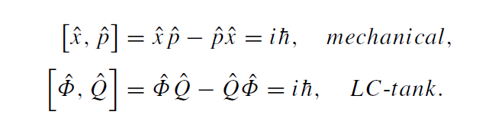
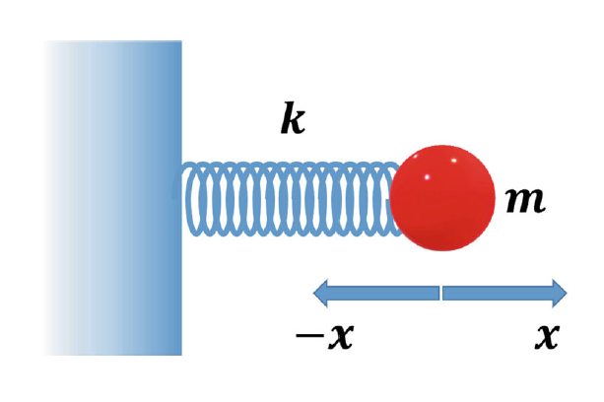
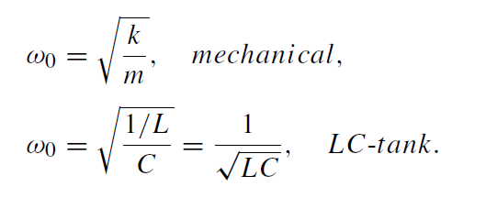
Quantization of LC Circuit
Learning outcomes: Understand the relationship between classical and quantum treatment of a LC tank

Slide 8
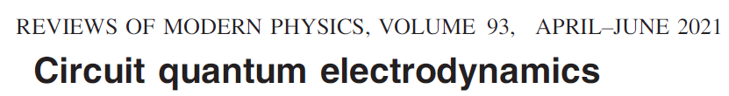
Quantization of LC Circuit
Learning outcomes: Understand the relationship between classical and quantum treatment of a LC tank

Slide 9
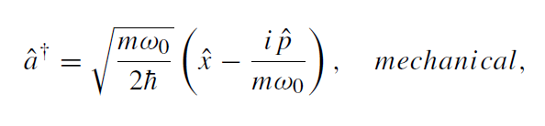
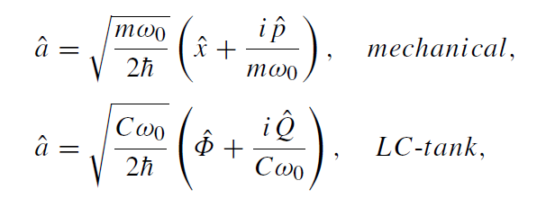
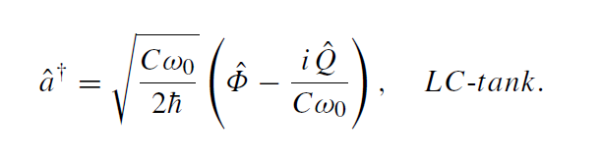
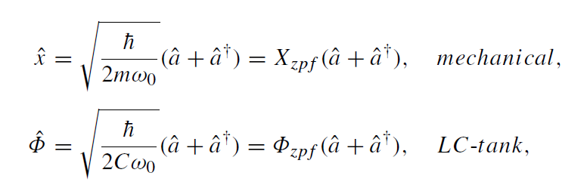
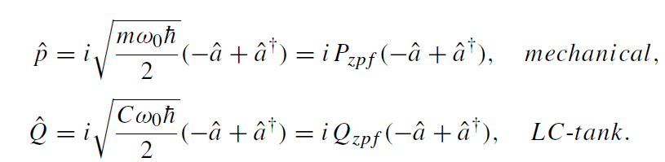
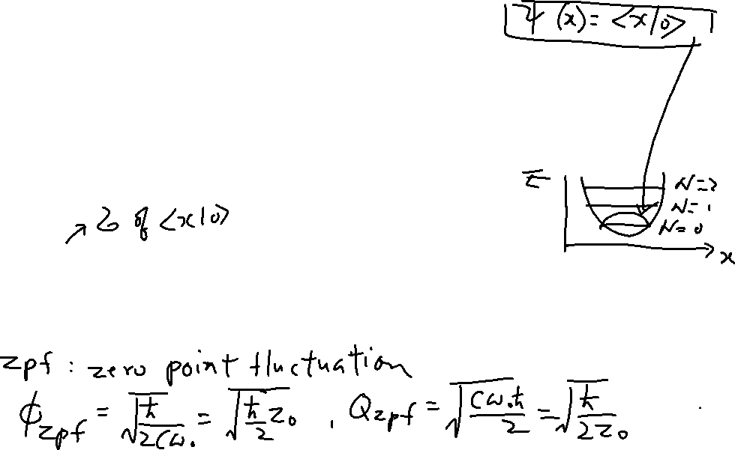
Quantization of LC Circuit
Learning outcomes: Relationship between mechanical and LC oscillator

Slide 10
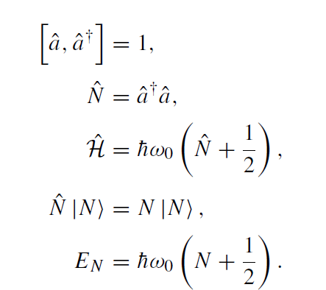
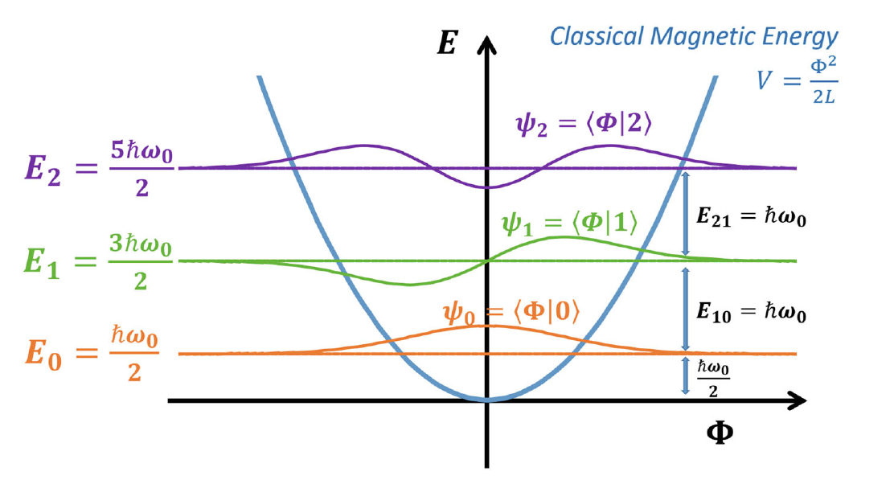

Quantization of LC Circuit
Learning outcomes: Relationship between mechanical and LC oscillator

Slide 11
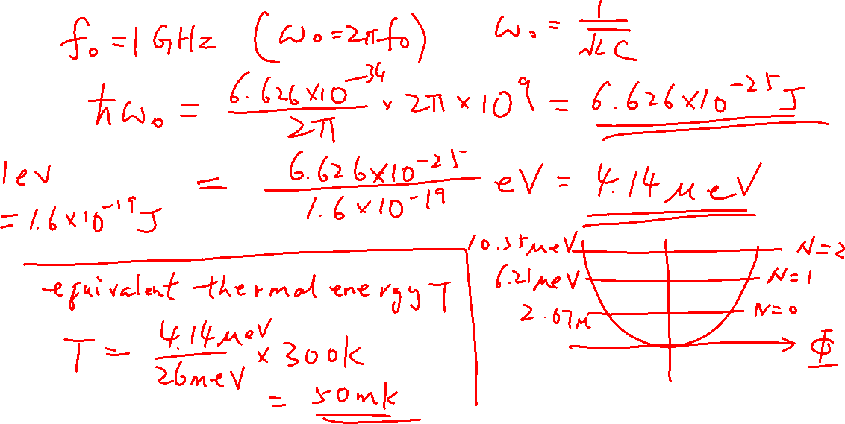
Quantization of LC Circuit – Numerical Example
Learning outcomes: Energy scale

Slide 12
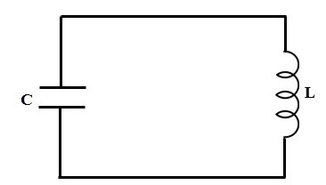

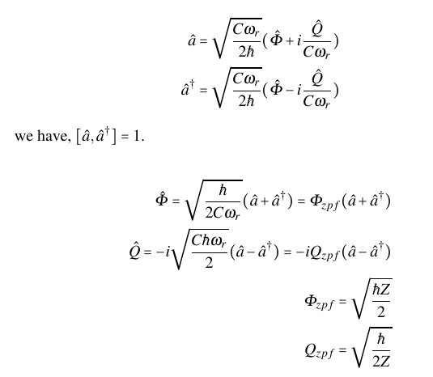
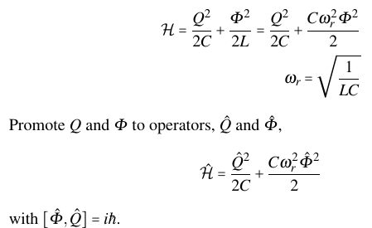
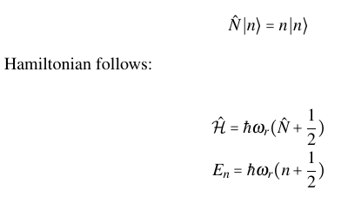
What did we Learn in the Last Lecture? Quantization of LC Tank

Slide 13
Superconducting Qubit Readout
Chapter 22 of “Quantum Computing Architecture and Hardware for Engineers: Step by Step”

Slide 14


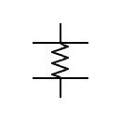
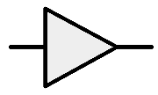
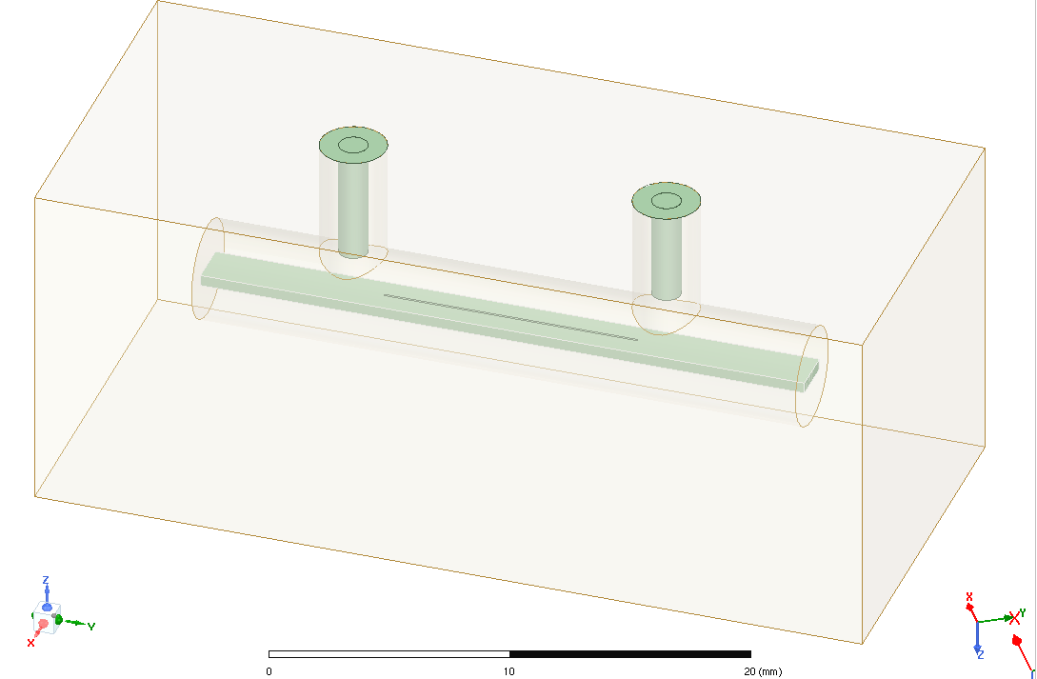
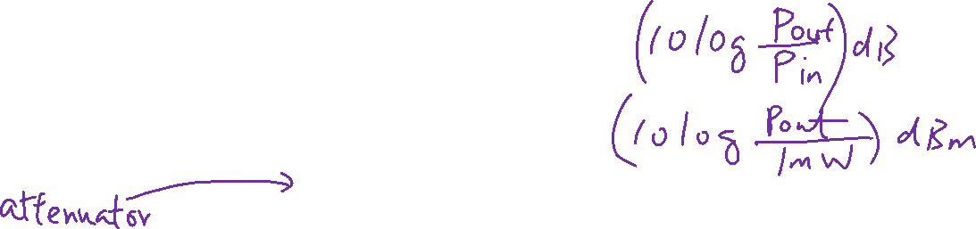
A Superconducting Quantum Computer
OPX Quantum Machines
Manipulation and reset
Readout
Amplifier
+40dB
Read Pulse: -47dBm at plate
300K
-20dB
HEMT
+40dB
Readout quality depends on
Readout Pulse Width (t_{p})
Readout Pulse Energy (E_{p})
Resonator quality factor
Noise
4K
-20dB
700mK
-20dB
Read Pulse: -123dBm at plate
10mK
363 photons (3500ns)
Resonator & Qubit
TWPA
+20dB
Hiu Yung Wong et al., "A Simulation Methodology for Superconducting Qubit Readout Fidelity," SSE, 2023.

Slide 15
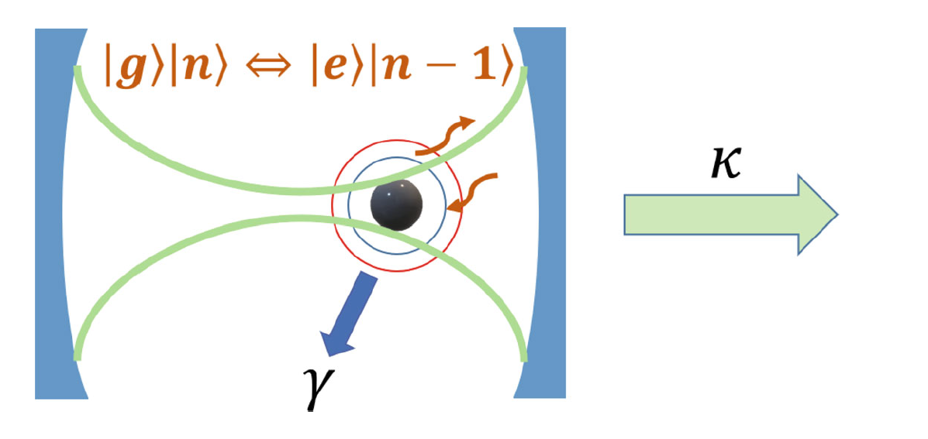
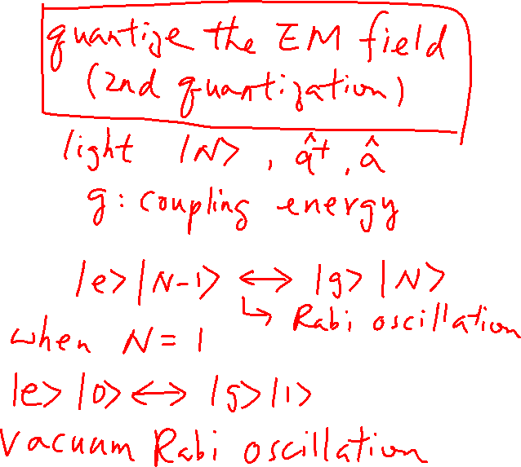
Cavity Quantum Electrodynamics (QED)

Slide 16
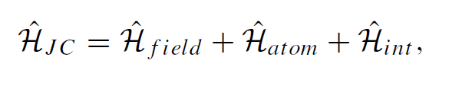
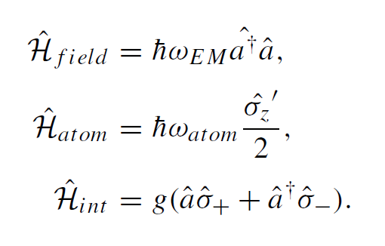
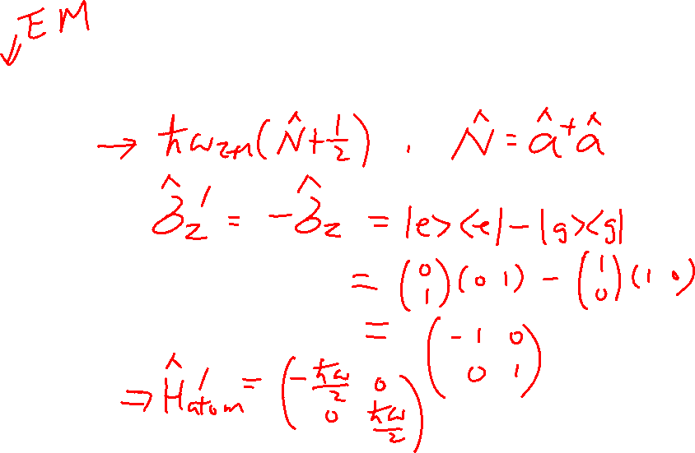
Jaynes-Cummings Hamiltonian Consider only 2 levels

Slide 17
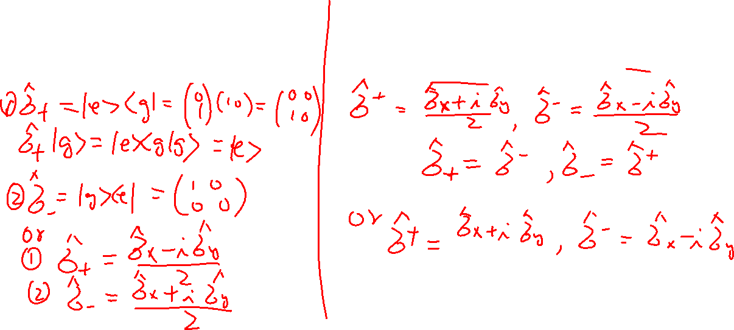
Raising and Lower Operators
raising and lowering operators of a
two-level system
raising and lowering operators of σ_{z}’s eigenvalues

